Slide 1
An unruly new realm of personal information distribution:
Social media and the law - developments
David Vaile
Executive Director
Cyberspace Law and Policy Centre
Faculty of Law, University of NSW
http://cyberlawcentre.org/

Slide 2
Outline
Regulation
Lessig and Code
Online and Social media impacts
Technological changes
Legal disconnects
Struggle for regulators to keep up
Special Features of the online social environment
A ‘wicked problem’?
Infinitely Long and Short
Australian v International material
IT security: Perimeter must fail
Four horsemen of the personal info sedurity apocalypse
Challenges for regulation
Recent Prosecutions
Where are we left?

Slide 3
Lawrence Lessig’s Code
Lessig identifies possible sources of regulation
(Code and other laws of cyberspace – 2.0) http://codev2.cc/
  Law (black letter, cf. actually enforced? Privacy?)
  Technology itself, a.k.a. 'Code’ (functions/limits)
  Social norms (netiquette, social practices?)
  Business practice (new social host busines models, where the user is product, not customer?)

Slide 4
Online and social media impacts
Tech changes
Cultural changes
Legal changes

Slide 5
Technological changes underlying
Offline world was nice and simple, for regulators and courts
Web 1.0: global publication, old media publish models: AustLII
Web 2.0: social networking, user generated content: Facebook 1
  Convergence of producer and consumer, + distributor
Web 3.0?: mass personalisation, semantic web, wearable tech.
  It’s not just your friends who know you and what you mean
Attack of the killer toddlers – we are so old!
  Hackers retire at 15, kids turning tech. tables on parents, ‘slash’
  Facebook does not enforce own entry test of ‘at least 13 yrs old’

Slide 6
Ye Olde Worlde (–2006)
Publisher
Block here?
Reader
Viewer
Listener
Producer
Importer
Block here?

Slide 7
New fangled (SNS/UGC)
Producer
Publisher
Reader
Producer
Publisher
Reader
Producer
Publisher
Reader
Producer
Publisher
Reader
Producer
Publisher
Reader
ISPs: the new block point

Slide 8
And then there was ‘2.0’: Features
Social networking, user generated content, degenerate narcissism
Blurs boundary: Publishing cf. Personal Communications
From centralised one-to-many topology to distributed network
Everyone is both consumer and producer (‘prosumer’)
Everyone is a permanent global publisher; can be intermediary
Every device is an endless movie source: deluge of data
No editorial brain involved (both users and ISPs)? No selection?
ISP replaces Publisher as key point – very significant? iiNet

Slide 9
Legal disconnects:
‘Info just wants to be free’?
Cyberlibertarian fantasies still delude and excite (Decl. of Indep. ‘96)
Reality: Jurisdiction out of control, hyper liability (for you)
  Intensification, not escape, from jurisdiction (revenge of the States)
Or: no care, and no responsibility? (for the Cloud)
  Your data and business go offshore, but not legal protection?
The rise of the sub-human: minors at the frontier
  Deficit in ‘consequences’ cognitive development: paternalism?
  ‘Under the age of 18 or appears to be under 18’: kids make porn?
The fall of the ‘common carrier’: ISPs reluctantly change masters?
  Agents of a foreign power, or a hostile litigant interest? CoE CC
  Enforced discipline of their customers, on pain of sharing liability?

Slide 10
The struggle for regulators to keep up
Offline: centralised distribution, choke points: edit/publish
Web 1.0: more distributors, easier importation
Web 2.0: everyone is a creator, (re)-publisher, exporter
Web 3.0: the Cloud knows what you like, and makes it?
Encryption and roll-your-own protocols already in use
The long cyber-war: endless arms race between the straiteners and those seeking to avoid the blocks? Enlivened by real armies.
When is publication not publication?
Confused discussion: Surely it is censorship? No First Amdt.
Chinese solution: you never know: the Panopticon:
(no-one home, but you self censor)

Slide 11
Special Features of the Online Social Environment
Lifespan
Cultural changes
Legal changes

Slide 12
Why online media control might be a ‘wicked problem’
Rapid constant evolution of technology, cultures and practices
Scope is unmanageable? A billion FB users, a trillion items
Classification model unviable? Urge to ‘filter’ - terminology
Design philosophy of the net – under attack? Or net resists all?
Supposed beneficiaries of protection also main perpetrators?
Moral panic: ‘The Panic Button’ as solution? Overcriminalised?
Real targets are parents? Wishful thinking? Or real victims?
Temptations of ‘policy-based evidence’? Filter, safety, retention...

Slide 13
Infinitely long and short lifespans
‘The Document that Never Dies’
Google Cache: days [next]
Internet Archive/
Wayback Machine: years
http://archive.org/ [next]
Pandora (NLA)
http://pandora.nla.gov.au/
Legitimate personal copies
Illicit personal copies
Facebook’s ‘inactive’ accounts: creature from the black lagoon?
‘Document that Hardly Ever Lived’
Instant messaging, text:
Arab Spring 2.0 demonstrates they are not really transient, but used as if... ?
Snapchat: www.snapchat.com
  A smartphone app shares photos and videos that self-destruct after viewed once for up to 10 seconds; warns if recipients attempt to capture screen? [Next]
Tor: encrypted onion router/VPN
Fast Flux injection: malware staple
Roll your own protocols and tools!
DFAT, former ASIO, chief declines to commit to writing (Zygier case)

Slide 14
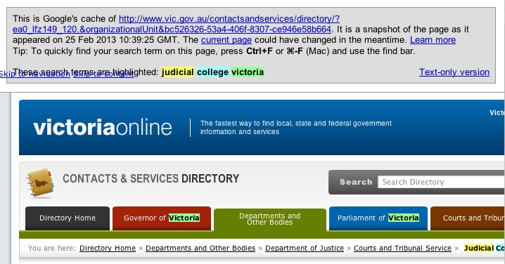
Cache

Slide 15
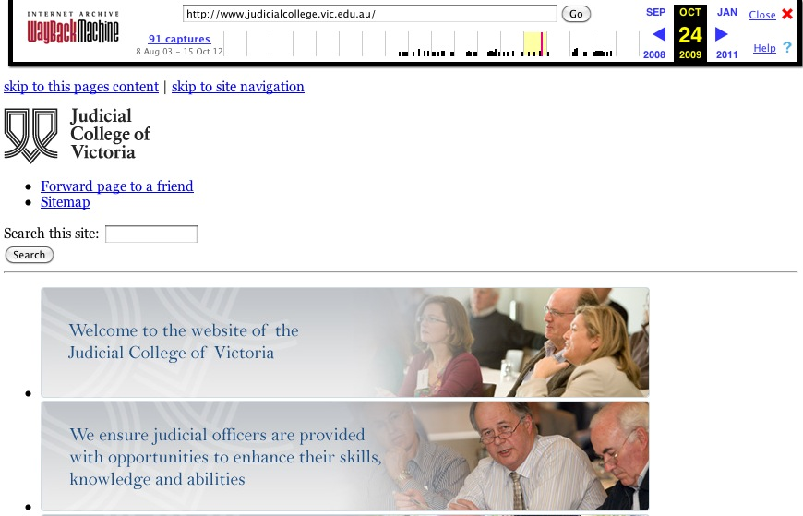
Wayback

Slide 16

SnapChat

Slide 17
Australian cf. international material
Extraterritoriality, foreign jurisdiction limits, ‘data sovereignty’
Difficulties for censorship, suppression, takedown, prosecution
Onshore: Notices (Content Takedown, Link deletion, Stream cessation) for items hosted in Australia from ACMA, Courts
  Directed not at author or owner, but ICH, intermediary
  No motive to resist? Or seek actual classification, review?
  No obligation online to classify, check, edit (cf film, game, publ.)
  ‘Prohibited’ or ‘Potentially prohibited’: RC, X18+, some R18+, MA15+
Offshore: ACMA blacklist based on complaint, Interpol C.P. blacklist in ‘voluntary’ ISP ‘filters’. Otherwise? Most untouched.
Potential to use Council of Europe Cybercrime Convention by, and in, USA and EU to streamline criminal prosecution: 1/3/13!

Slide 18
Perimeter security: FAIL
Firewall
Anti spyware
Common sense
Other IT security
Antivirus

Slide 19
Why IT perimeter security must fail
Needs to be 100% effective
For a connected device, 99.9% means that 0.1% loophole will be found, in seconds or weeks.
No IT security tools is even 99.9% effective.
The other side are in a constant arms race with the IT security providers and other vendors trying to keep them out.
They only need the tiniest crack – easy to achieve eventually
Constant innovation by some of the smartest IT people on the planet, and legions of ‘script kiddies’ using auto-mutating tools

Slide 20
Is IT security broken?
Unix IT security model (WinNT, Mac, *nix) doomed
  Assumes informed user. But complicated, we’re all bozos.
Perimeter defence model is doomed: 0.01% v 99.99%
  Hacktivists and crims can get into anything
  Minutes/hours before any honeypot compromised?
No basis for user decision to agree, click; false alarms.
Zombies & malware industrialise rapidly, mass customise
Implications: we definitely can’t keep them out, or info in.

Slide 21
Four Horsemen of the
[online privacy/security] Apocalypse
GOV’T
Overzealous
BUSINESS
Over-opportunist
CRIMs
Hacking
YOU
and Your ‘Friends’
Scams
OU

Slide 22
Why do these ‘Four Horsemen’ matter?
Presumption by many that government and industry are ‘here to help’, rather than ‘part of the problem’.
Much cyber-safety and cyber-security education material is distorted by this assumption
Good players in all four sectors, but serious risks from all too.
Failing to see this may blind users to the worst risks for them in a given situation. Courts may look in the wrong place.
Also conveniently avoids focusing attention on governance and public policy failures which create such institutional risks!

Slide 23
Challenges for regulation
Impossible to treat online content same as offline mass media
  Human classification, processing, review: orders too expensive
  Machine classification, automation: intrinsically ineffective
  Transparency and accountability (old) v. secrecy (new)?
No ambition/hope to classify/control all – but what to say to parents, victims, or litigants?
Complaints/reporting as a visible response... Then what?
Problem of the social network giants: too big to care, too big to afford to deal with individuals? ‘Customers’ cf. ‘Products’?
Potential of exemplary prosecutions? Shock of consequences?

Slide 24
Recent prosecutions
NSW Dist Ct.: Police v Ravshan USMANOV [2011] NSWLC 40
Publish Indecent Article, s578C of Crimes Act 1900 (NSW)
  Non-internet offence, old offence!
  Former partner, pictures posted, created during the relationship
  Intent to cause distress, a means of ‘getting back’ at former GF.
  Plea of guilty, failed bid to minimise sentence, 6 mo. suspended
  Poor legal advice, Dep CM unimpressed with ‘it was nothing’.
  No precedents, magistrate picks middle of range to start.
  Discount for plea (25%), then adds 25% for lack of contrition
  Dist Ct. approved 6 months result, agreed shd be suspended

Slide 25
Recent prosecutions (cont.)
Vic Bendigo Mag. Ct: Henderson 2011, breach intervention order
  Full admissions, said it was only harmless fun. No relationship.
  “couldn’t understand how she had proof he posted the comment”
  Illustrates lack of appreciation of both the harm and the evidence gathering capacity of online systems. Importance of data forensics!
McCrory and Turner, Aug 2012, same town! Revived 2013!
  ‘Root Raters’ – FaceBook’s original purpose?
  ‘Use carriage service to offend’: Criminal Code (Cth) s474.17?
  ‘publishing objectionable material online’: ??
  Jail terms reduced to Community Corrections Orders on appeal

Slide 26
Where does this leave us?
Ignorance of consequences a key driver
Will prosecutions make any difference?
The politics of gesture? Or just the shock needed?
Will we ever have a proper discussion of needs of young pp?
Failure of local and US regulators to hold giants to account creates culture of impunity – rewards ‘see if you can get away with it’ not compliance. Absence of auditing and protection for individuals’s data?
Uncertainties in user requesting or court ordering takedowns.

Slide 27
Questions?
David Vaile
Cyberspace Law and Policy Centre
Faculty of Law, University of NSW
http://www.cyberlawcentre.org/
d.vaile@unsw.edu.au
0414 731 249

